Slide 1
AI-Based Real-Time Crowd Density Alert System
Presented by
BENJAMIN NICOLAS S(221801005)
CHARLESS BINNY K (221801007)
HARSHITHA R (221801018)

Slide 2
PROBLEM STATEMENT
Many public venues lack an affordable and efficient system for monitoring crowd density in real-time, which is essential for ensuring public safety and managing high-traffic areas. Traditional surveillance solutions are often expensive and complex, requiring dedicated hardware and infrastructure. This project addresses these issues by developing a lightweight, web-based crowd monitoring system that uses a mobile phone as a live camera source and integrates YOLO-based person detection to estimate crowd density. The application provides a simple login interface, a dashboard with a live map, and a real-time video feed, triggering alerts when crowd levels exceed a predefined threshold—offering a scalable, low-cost, and accessible alternative to conventional crowd monitoring systems.

Slide 3
ABSTRACT
This project presents a real-time crowd density monitoring system that utilizes a mobile phone as a live video source and employs the YOLO object detection algorithm to detect and count individuals in the scene. The system is designed as a web-based interface with three main components: a secure login page, a dashboard displaying a live location map, and a live camera feed for real-time monitoring. When the number of people detected in the video feed exceeds a predefined safety threshold, the system triggers an alert to notify users of potential overcrowding. By combining the accuracy of YOLO with the accessibility of mobile devices and web technologies, the system offers a low-cost, scalable solution for managing crowd density in public spaces such as events, malls, and transportation hubs.

Slide 4
INTRODUCTION
Managing crowd density is important for safety and smooth operations in public places like events, malls, and transport hubs. Traditional monitoring systems often require expensive cameras and complex setups, making them hard to implement in smaller or temporary venues.
This project provides a simple and cost-effective solution by using a mobile phone as a live camera and the YOLO object detection model to detect and count people in real time. The system features a user-friendly web interface with a login page, a dashboard showing a live map, and a live video feed. When the number of people crosses a set limit, an alert is triggered to help prevent overcrowding.
By combining real-time video processing with an accessible interface, this project offers an efficient way to monitor and manage crowds using minimal hardware and widely available tools.

Slide 5
EXISTING SYSTEM
Current crowd monitoring solutions often rely on fixed surveillance infrastructure, such as CCTV-based systems, sensor networks, and AI-enabled surveillance platforms. These systems are typically used in airports, stadiums, and large event venues to track crowd flow and detect overcrowding. While they provide reliable data, they usually require costly hardware, complex setup, and ongoing maintenance, making them less practical for small-scale or temporary use. Additionally, most of these systems depend heavily on internet connectivity and centralized processing units, which can create delays or data bottlenecks.
Some are:
Cisco Meraki MV Smart Cameras – AI-enabled cameras with built-in analytics for crowd counting.
CrowdVision – A real-time crowd analytics platform used in airports and transport hubs.
Viisights Wise – A video analytics system that detects behaviors and density levels in public areas.

Slide 6
LIMITATION OF EXISTING SYSTEM
High cost of installation and specialized hardware.
Limited flexibility for temporary or mobile deployments.
Complex setup and maintenance requiring technical expertise.
Dependence on stable network infrastructure for cloud processing.
Privacy concerns due to continuous video surveillance and data collection.

Slide 7
PROPOSED SYSTEM
The proposed system offers a lightweight, real-time crowd density monitoring solution using a mobile phone camera and the YOLO object detection model, integrated into a web-based interface. It provides an accessible and cost-effective alternative to traditional surveillance by automating crowd detection and alert generation without requiring complex hardware or setup.
Mobile Camera Integration – A standard smartphone is used as the live video source, eliminating the need for expensive surveillance equipment and enabling flexible deployment in various environments.
YOLO-Based Person Detection – The YOLO model processes the video feed to detect and count individuals in real time, providing accurate crowd estimation with minimal latency.
Threshold-Based Alert System – When the number of detected people exceeds a predefined threshold, the system automatically triggers an alert to warn about potential overcrowding.
Web-Based Dashboard – Users can log in to access a live dashboard displaying the current crowd status, an interactive map, and a camera feed, allowing remote monitoring and easy management.

Slide 8
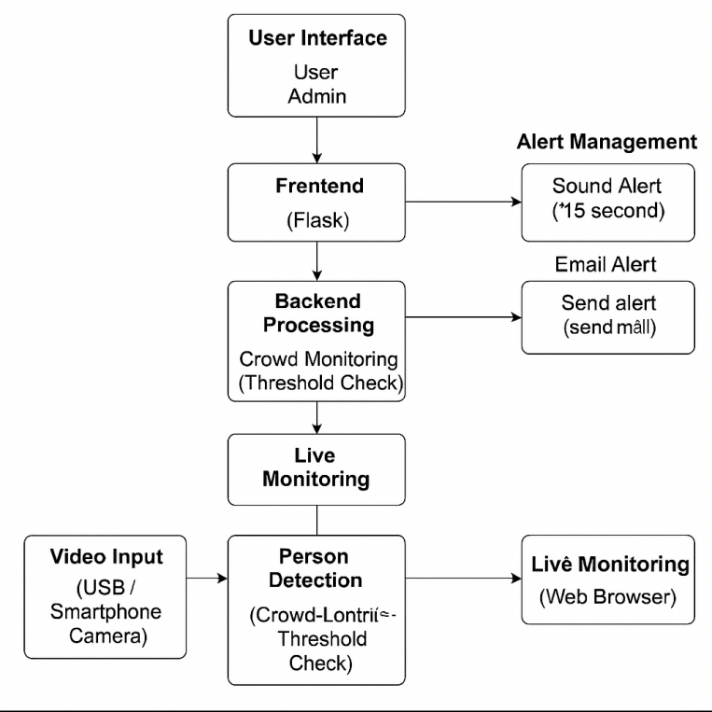
ARCHITECTURE DIAGRAM

Slide 9
PERSON DETECTION MODULE
Uses YOLOv8 for real-time person detection.
Filters only the 'person' class from all detected objects.
Draws bounding boxes and labels each person with confidence scores.
Calculates the total people count per frame.
Uses OpenCV and Ultralytics libraries for model inference and display.

Slide 10
VIDEO STREAM PROCESSING MODULE
Captures live video from laptop webcam, USB camera, or phone camera.
Uses OpenCV to read, resize, and annotate each frame.
Sends each frame to the person detection module for analysis.
Handles frame refresh and UI-ready output for real-time display.
Supports different resolutions based on user configuration.

Slide 11
ALERT GENERATION MODULE
Monitors the crowd count and checks it against a threshold.
Triggers an audio alert (15-second alarm or beep) when exceeded.
Sends an email alert with crowd details to a configured recipient.
Uses playsound / winsound for audio, and smtplib for email.
Ensures alerts are timely, reliable, and non-repetitive.

Slide 12
FLASK-BASED STREAMING MODULE
Streams the annotated video via Flask using the /video endpoint.
Converts OpenCV frames into MJPEG stream for web embedding.
Allows live access to detection output from any web browser.
Keeps backend and frontend loosely coupled and independently accessible.
Simple to host locally or on a LAN network.

Slide 13
FRONTEND DASHBOARD MODULE
Built using React.js and styled with Tailwind CSS.
Includes a Login Page for user/admin authentication.
Features a Dashboard Page with Google Maps and navigation buttons.
Displays the Camera Feed Page by embedding the Flask video stream.
Easy-to-use UI with animated transitions (via Framer Motion).

Slide 14
CONFIGURATION AND MANAGEMENT MODULE
Allows setting the crowd threshold for alerts.
Supports custom video resolution and stream source.
Lets user configure email credentials and recipients.
Enables customization of box color, thickness, and label size.
Makes the system flexible and adaptable to various environments.

Slide 15
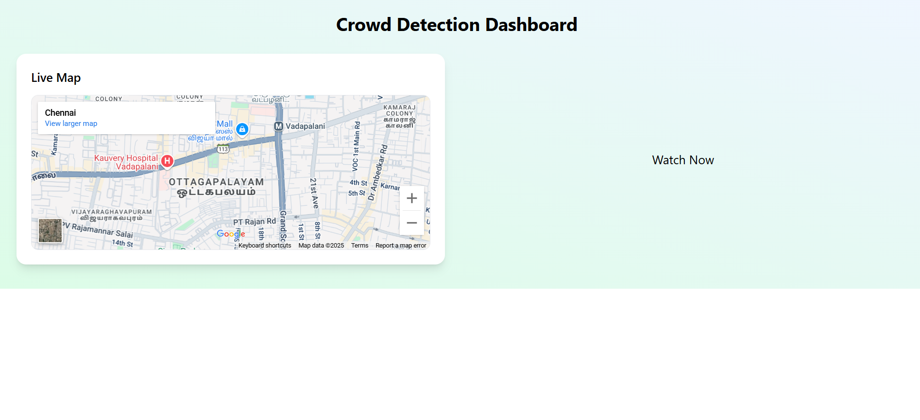

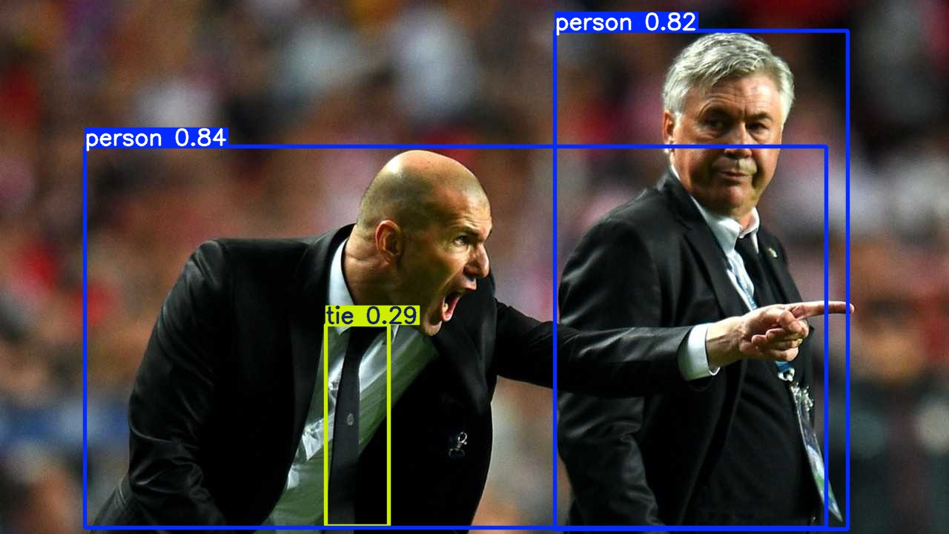
OUTPUTS

Slide 16
THANK YOU!!

